Slide 1
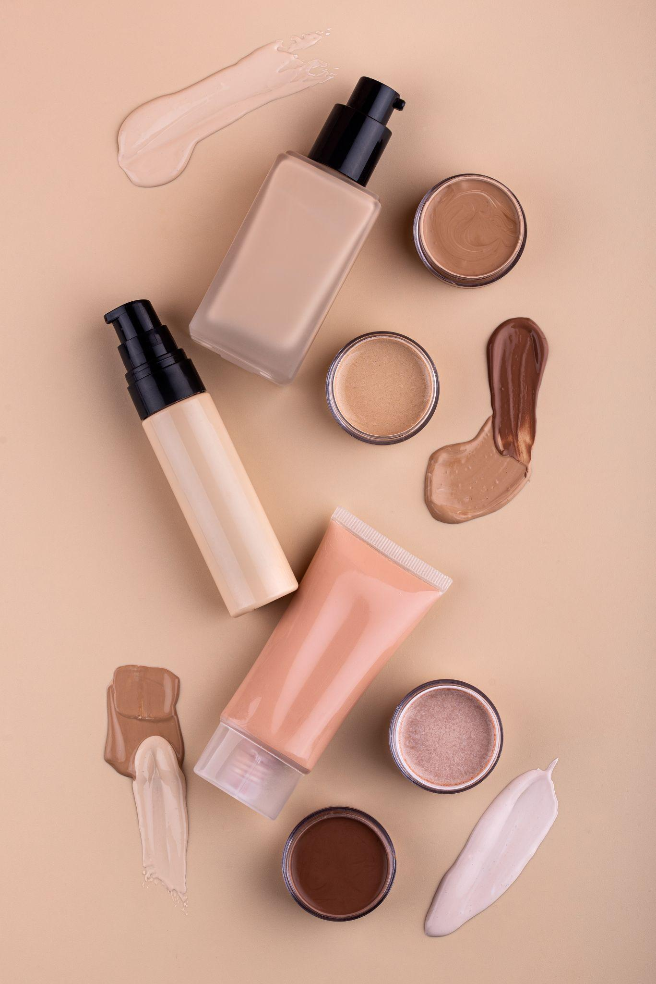

Midshi Cosmetic Shop
Ishita S Savera
22030501046
MCA Semester-4
Internal Guide : Prof. Nidhi Chitroda
Darshan University

Slide 2
Outline
Introduction
Project Profile
Abstract
Problems of existing system
Advantages
Limitation
Use Languages
Day Sheduling
Data Dictionary
Screen Shorts

Slide 3
Acknowledgment
I am the student of M.C.A studying in the Darshan University. Thanks the entire person who has landed their support in shaping of the systemic.
I have great deal of gratitude towards our Head of Department who encourage us in taking up this activity. I thank all faculties and administrative staff of the institute in enhancing their cooperation.
I thank Prof. Nidhi Chitroda before giving us full guidance and cooperation in understanding the system. I also thank them for their unconditional help in making of this project.

Slide 4
Project Profile
Developed By | Ishita S Savera
Operating System | Microsoft Windows 11
Editor | Subline , Visual Studio Code
Web Server | Xampp
Web Browser | Internet Explorer 6.0, Mozilla , Firefox, Google Chrome , Opera.
Guided By | Prof. Nidhi Chitroda

Slide 5
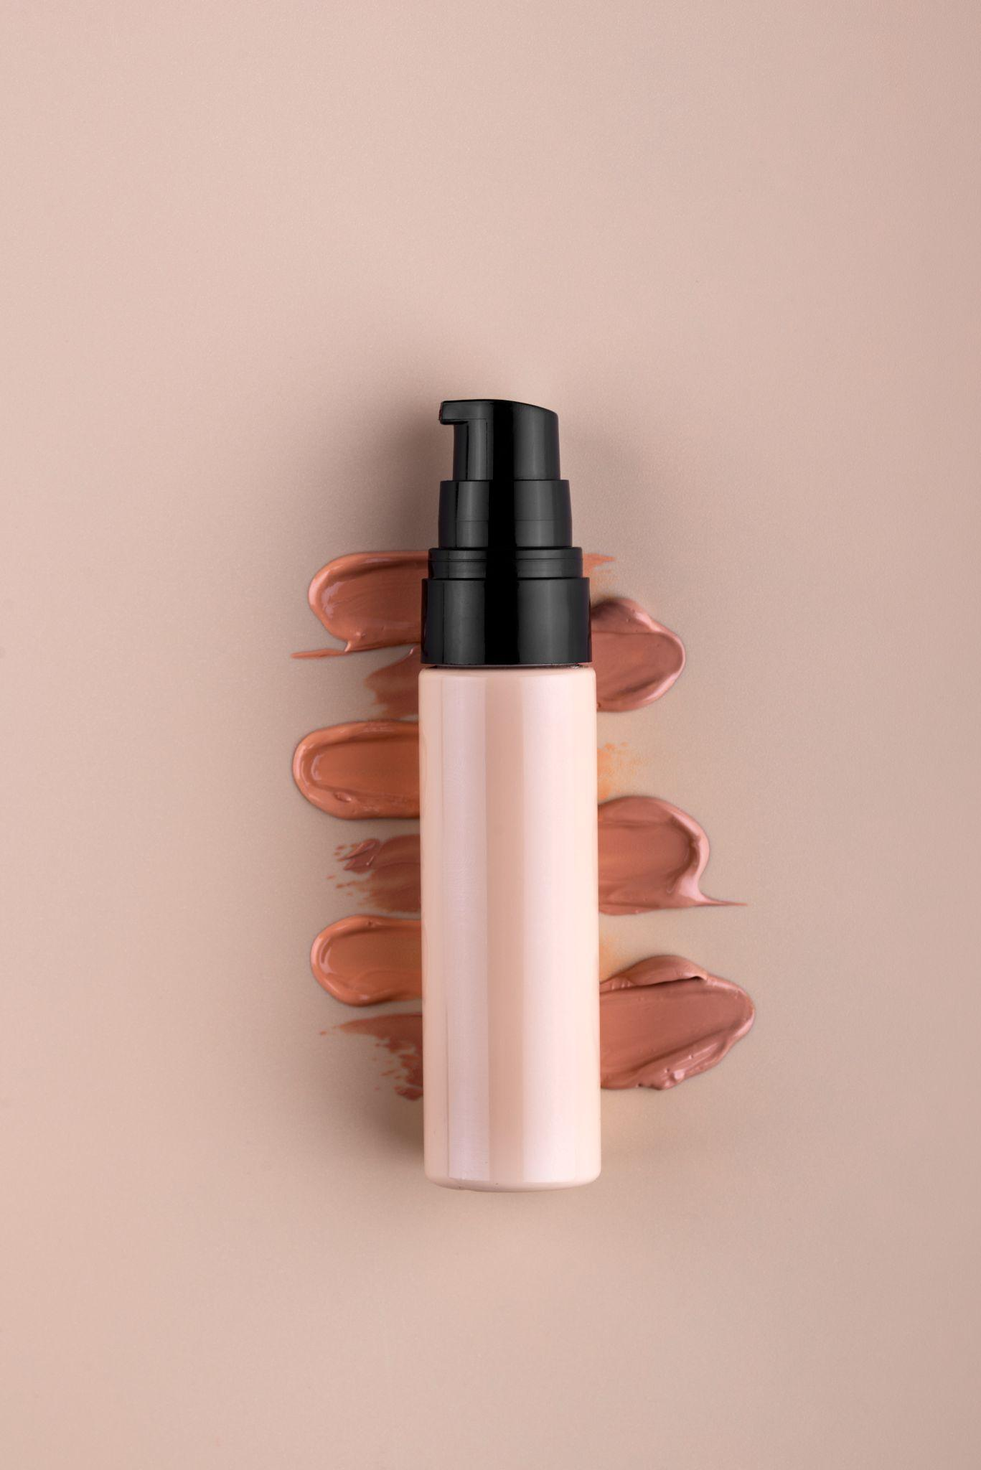
Abstract
A cosmetic shop serves as a retail space where customers can purchase a variety of beauty and personal care products. The primary purpose of a cosmetic shop is to provide consumers with a convenient and dedicated space to explore, try, and purchase a wide range of cosmetic items.

Slide 6
Problems of Existing System
Issue no. 1 Transparency, traceability, sustainability
Three parts of one big issue for the beauty & cosmetics market. With growing public awareness over plastics, animal testing, water pollution, palm oil, and worker exploitation (and that list is not exhaustive), beauty & cosmetic brands are having to provide transparency and in many cases review and adapt their products to remain true to customer’s desires. Consumers want visibility all the way back to origin, they want clearer labelling, and they want assurance that the products they are buying are in line with their ethics.
Issue no. 2 – Online/Offline
In recent years there has been a blurring in the way we shop for beauty & cosmetics. Online sales are helping drive the market, with around half of the growth coming from online sales. Social media has added benefit and complexity in equal measure, with users sharing their experiences, reviews and advice about products with thousands of others at the click of a button. This can be great for exposure if the review is positive, but if not, product sales can really suffer. However, the store does remain an important element in this market. As much as beauty & cosmetics retailers have invested in their online sites, they just cannot replicate the results of trying cosmetics in the store. Consumers though want choice in how they shop – they may browse online and then come in to the store to test and make a purchase, or some shoppers may look and test products in-store and then make their purchase online.

Slide 7
Advantages
Product
Information:
Comparison Shopping:
Special Discounts and Promotions:
Online platforms often provide detailed product descriptions, ingredient lists, and customer reviews, helping customers make informed decisions about their purchases.
Consumers can easily compare prices, features, and reviews of different products and brands, enabling them to find the best value for their money.
Online cosmetic shops frequently offer exclusive discounts, promotions, and loyalty programs, allowing customers to save money on their favorite products.

Slide 8
Limitations
1. Payment Method Issues:
Ensure that the payment information you entered is accurate. Double-check the credit card number, expiration date, CVV, and billing address.
2. Inventory Limitations:
The products you're trying to purchase may have limited availability. If there's insufficient stock for one or more items, the platform may prevent you from buying them together.
3. Website or Platform Restrictions:
Some online platforms or websites may have restrictions on the number of items you can purchase in a single transaction. Check the platform's terms of service or product purchase policies for any limitations.

Slide 9
Use Language And Framework
PHP
HTML
CSS
Bootstrap
JS

Slide 10
Module List
Show Category
Show Product
Order Product
Payment
Add Category
Add Product
Delete Product
Delete Category

Slide 11
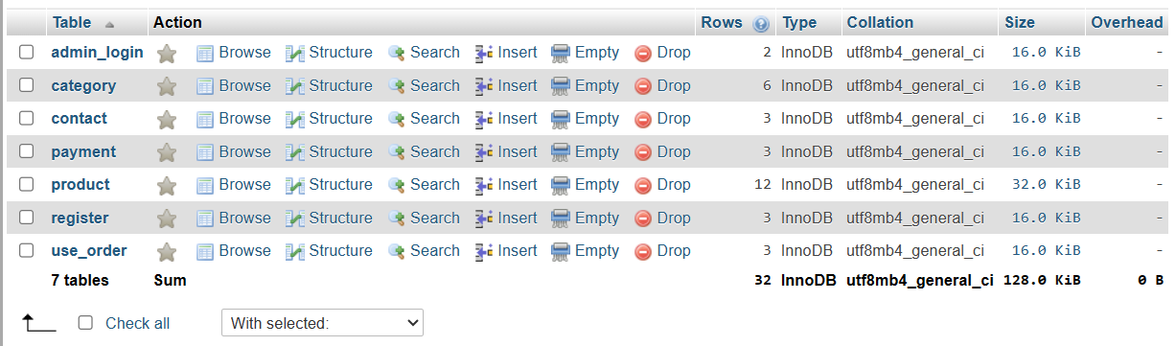
Data Dictionary

Slide 12
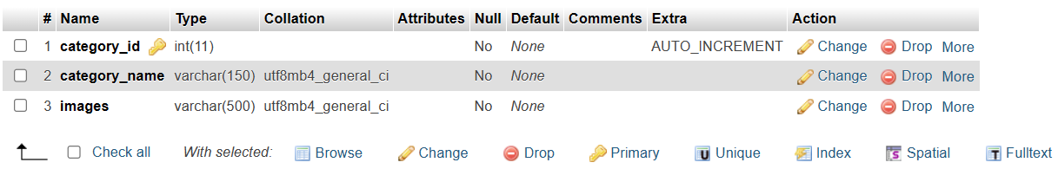
Category

Slide 13
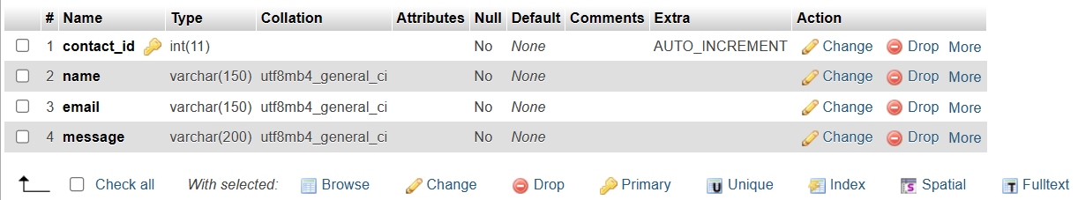
Contact

Slide 14
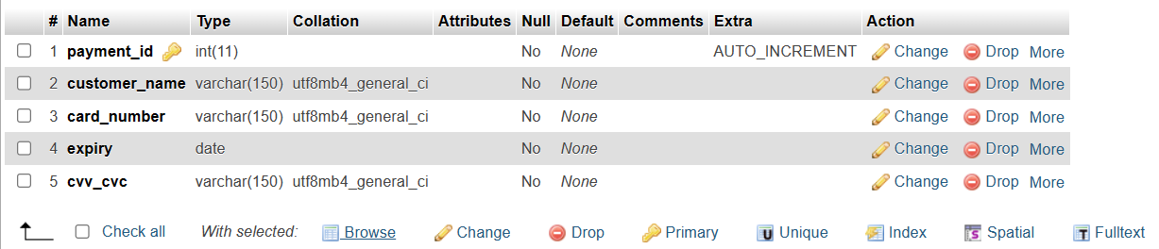
Payment

Slide 15
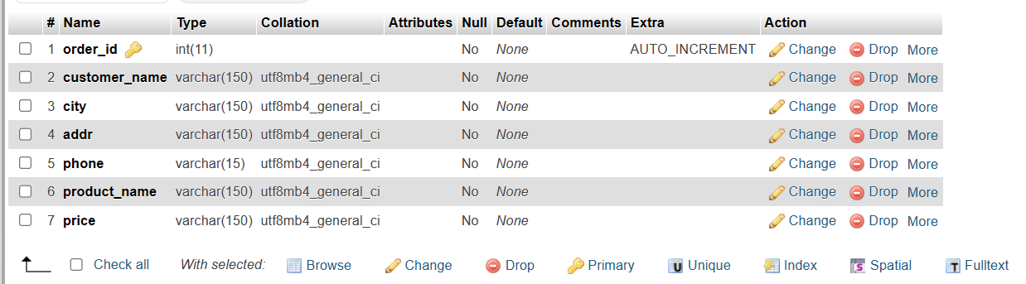
Order

Slide 16
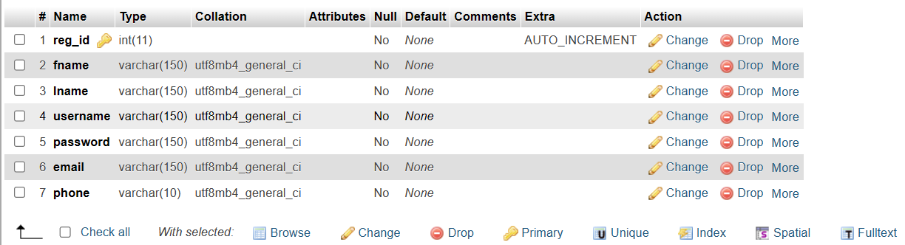
Register

Slide 17
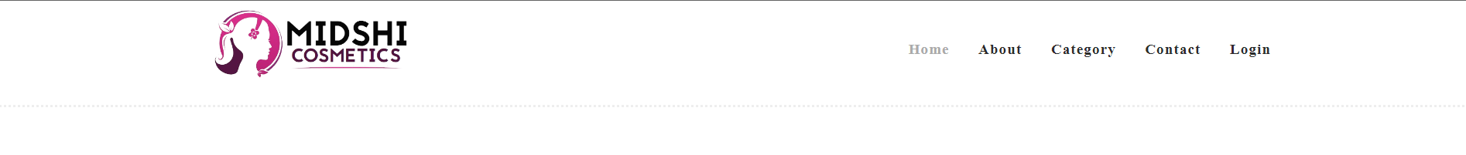
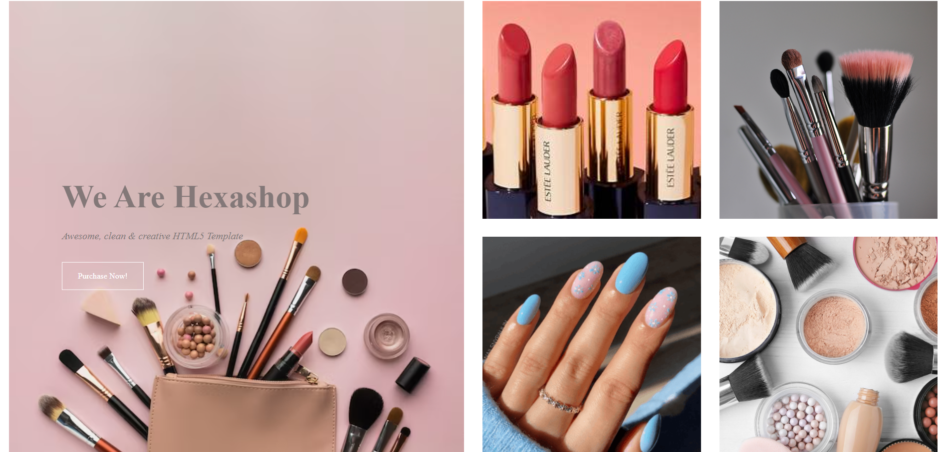
Home

Slide 18
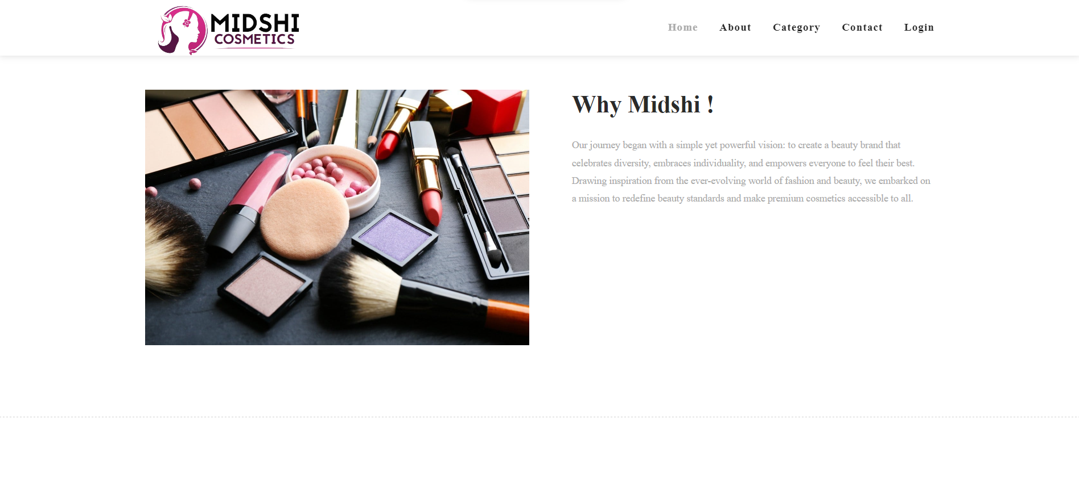
About

Slide 19
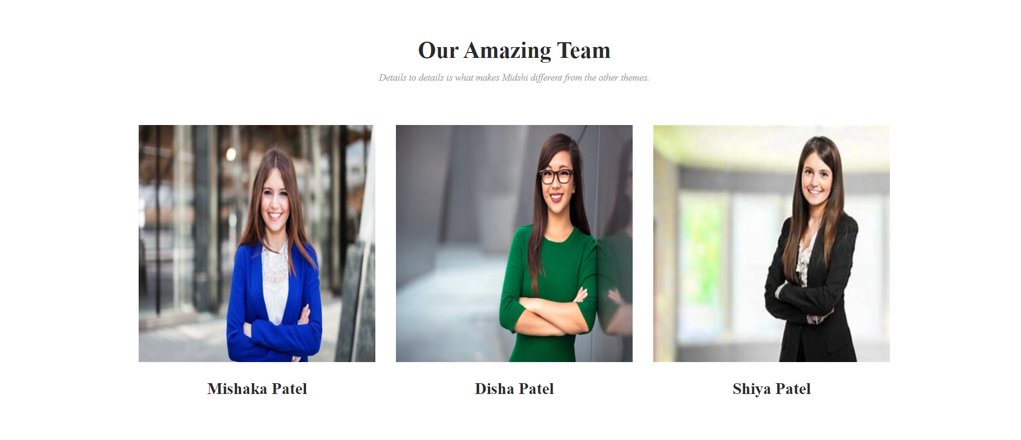
Our Team

Slide 20
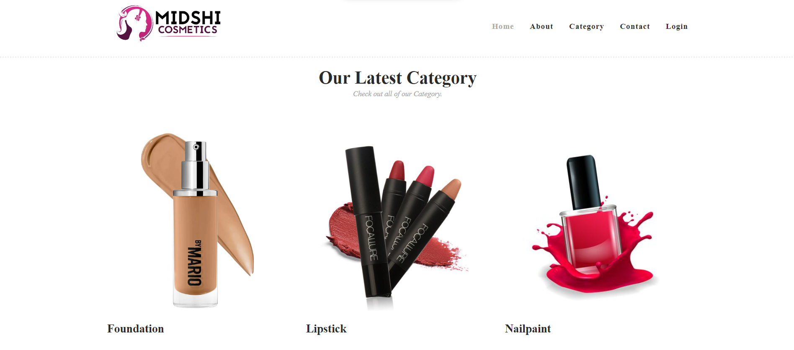
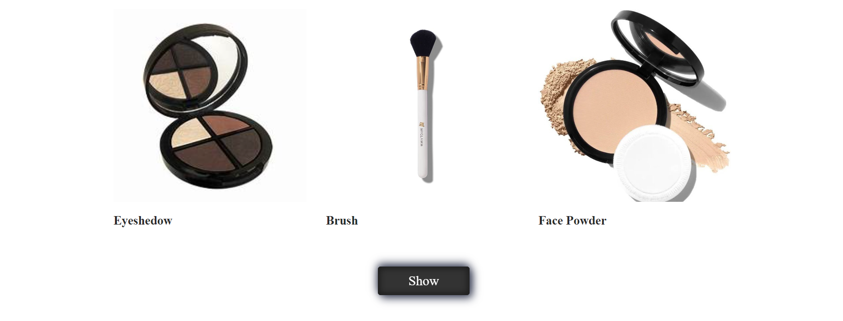
Category

Slide 21
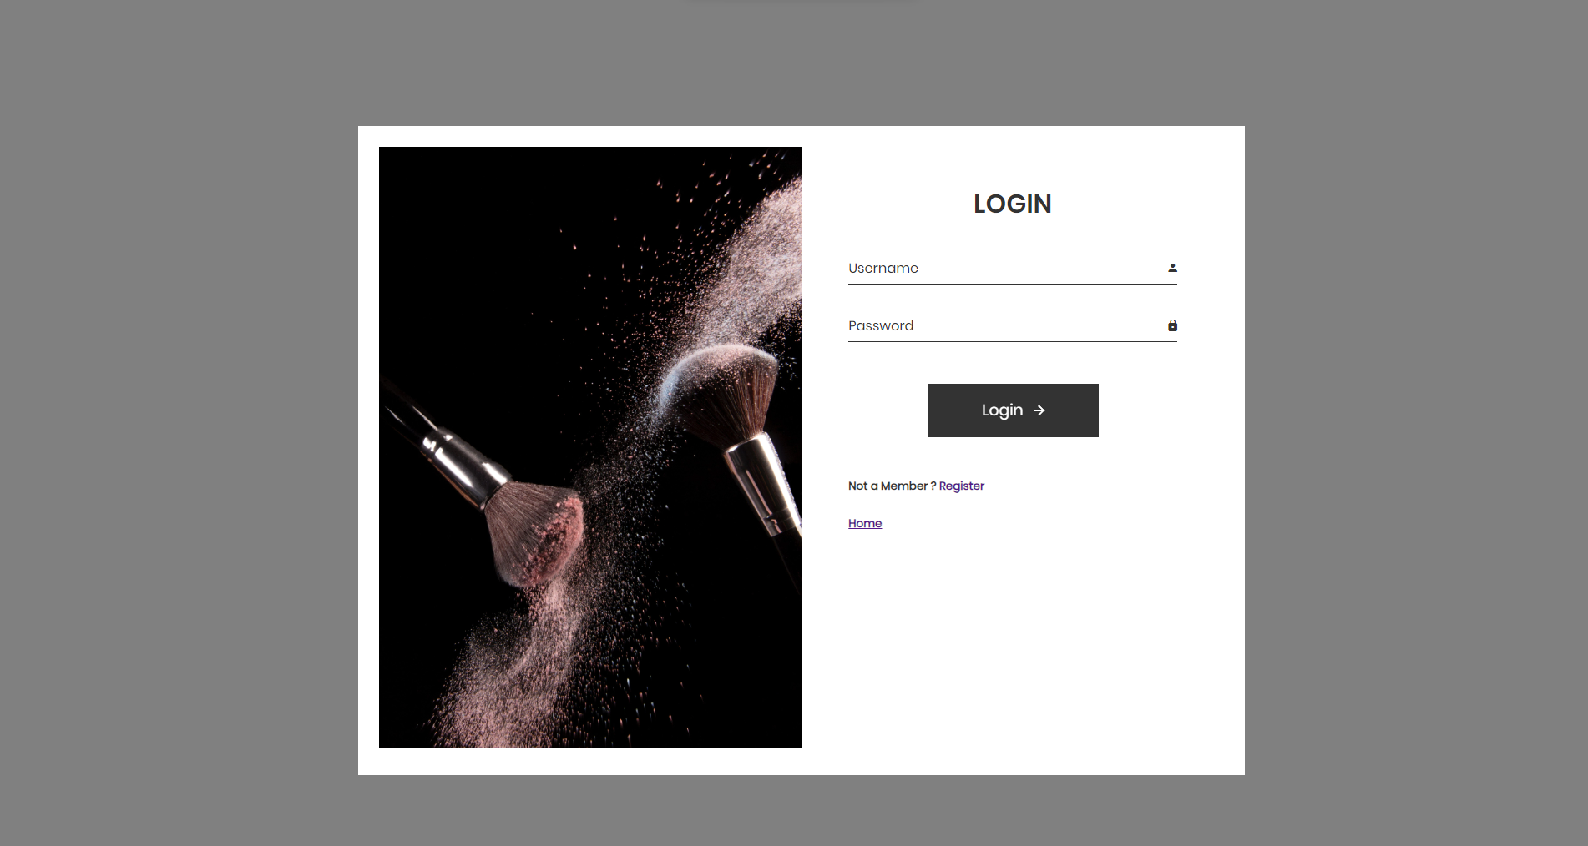
Login Form

Slide 22
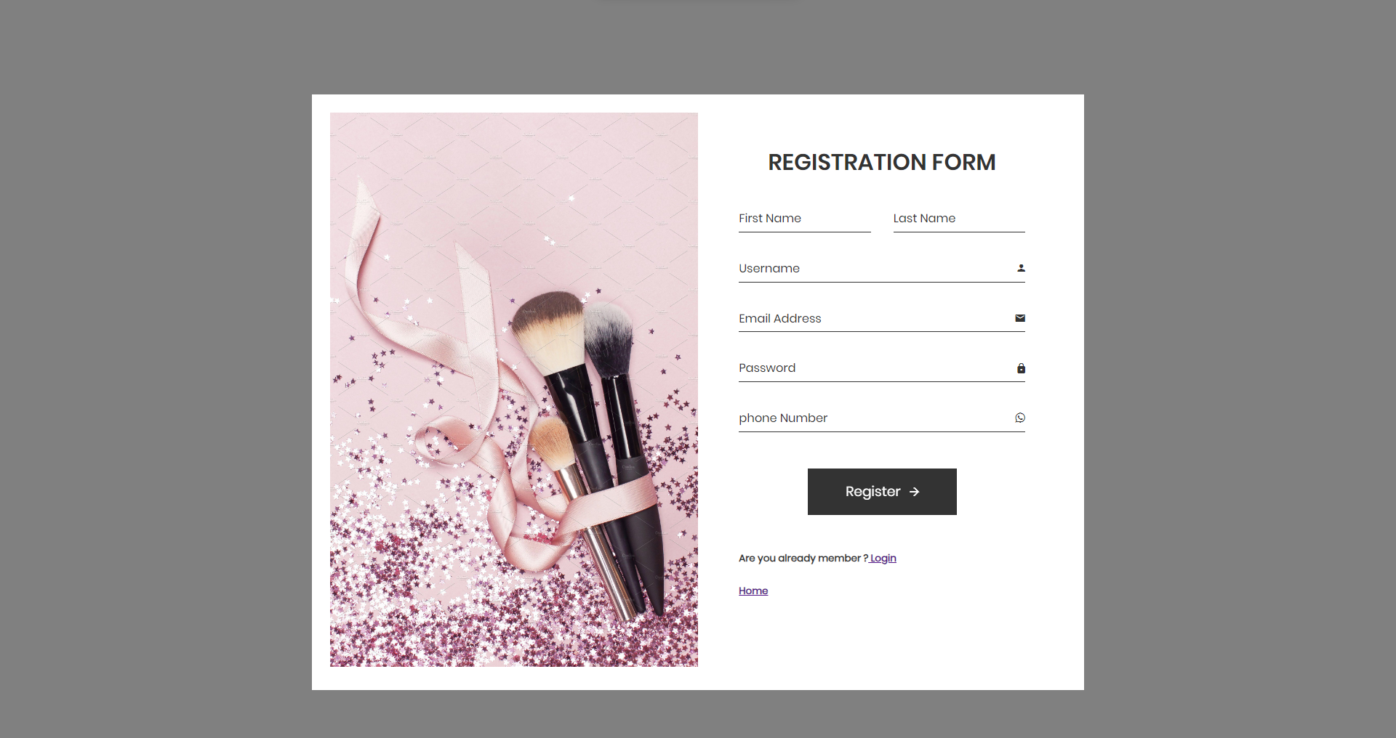
Registration Form

Slide 23
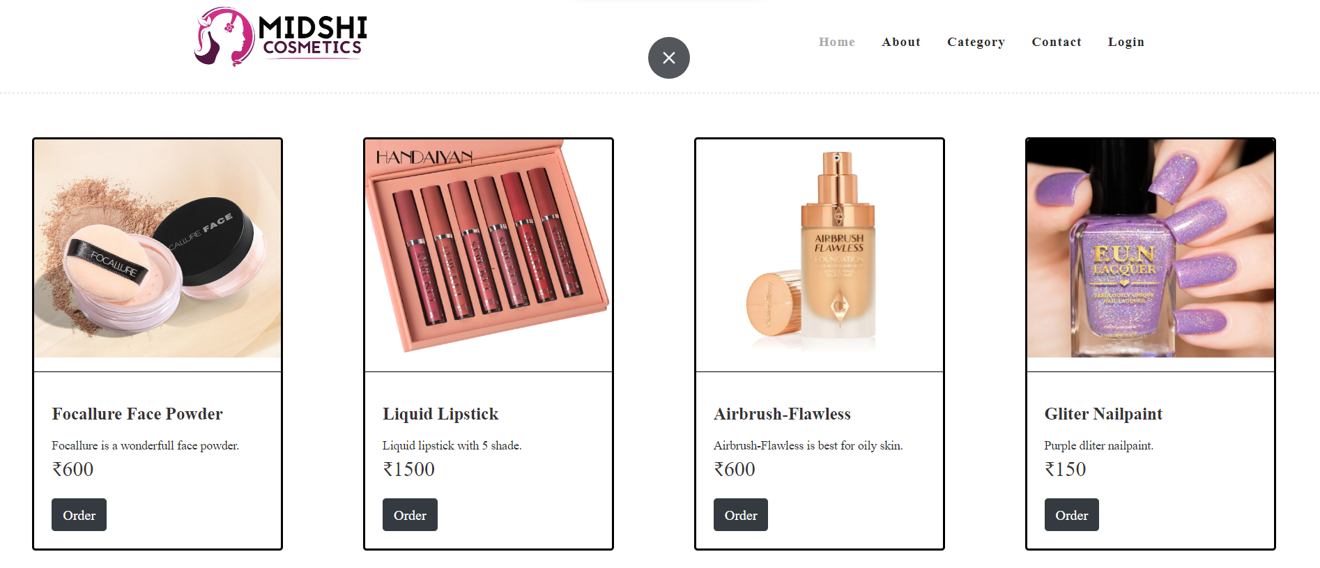
Product

Slide 24
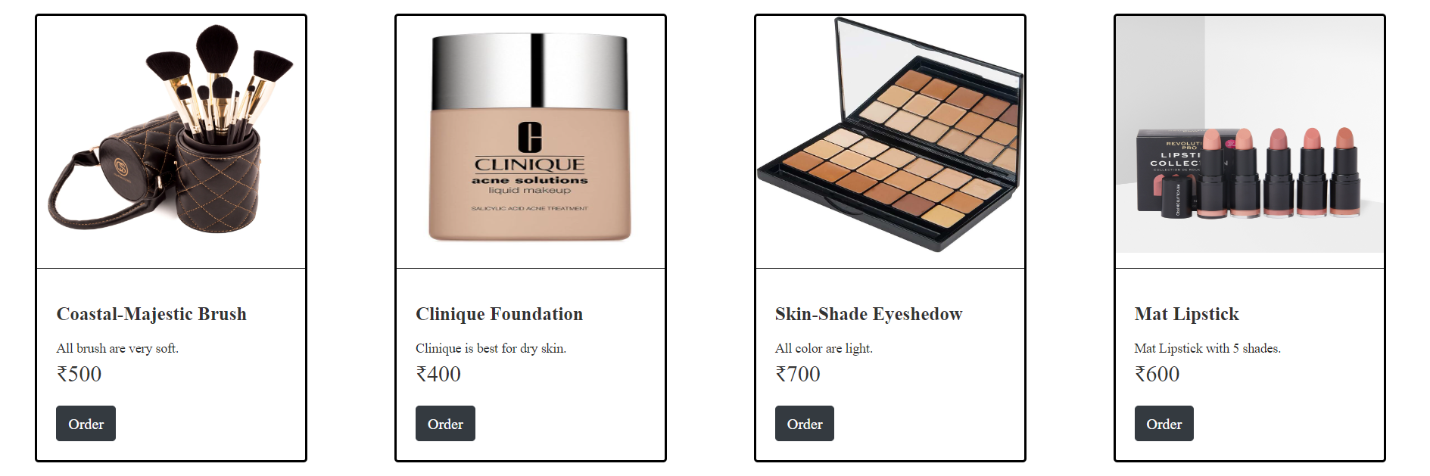
Product

Slide 25
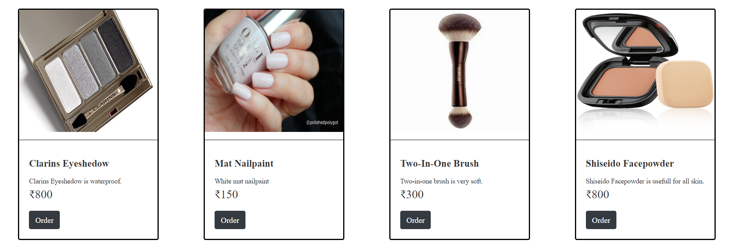
Product

Slide 26
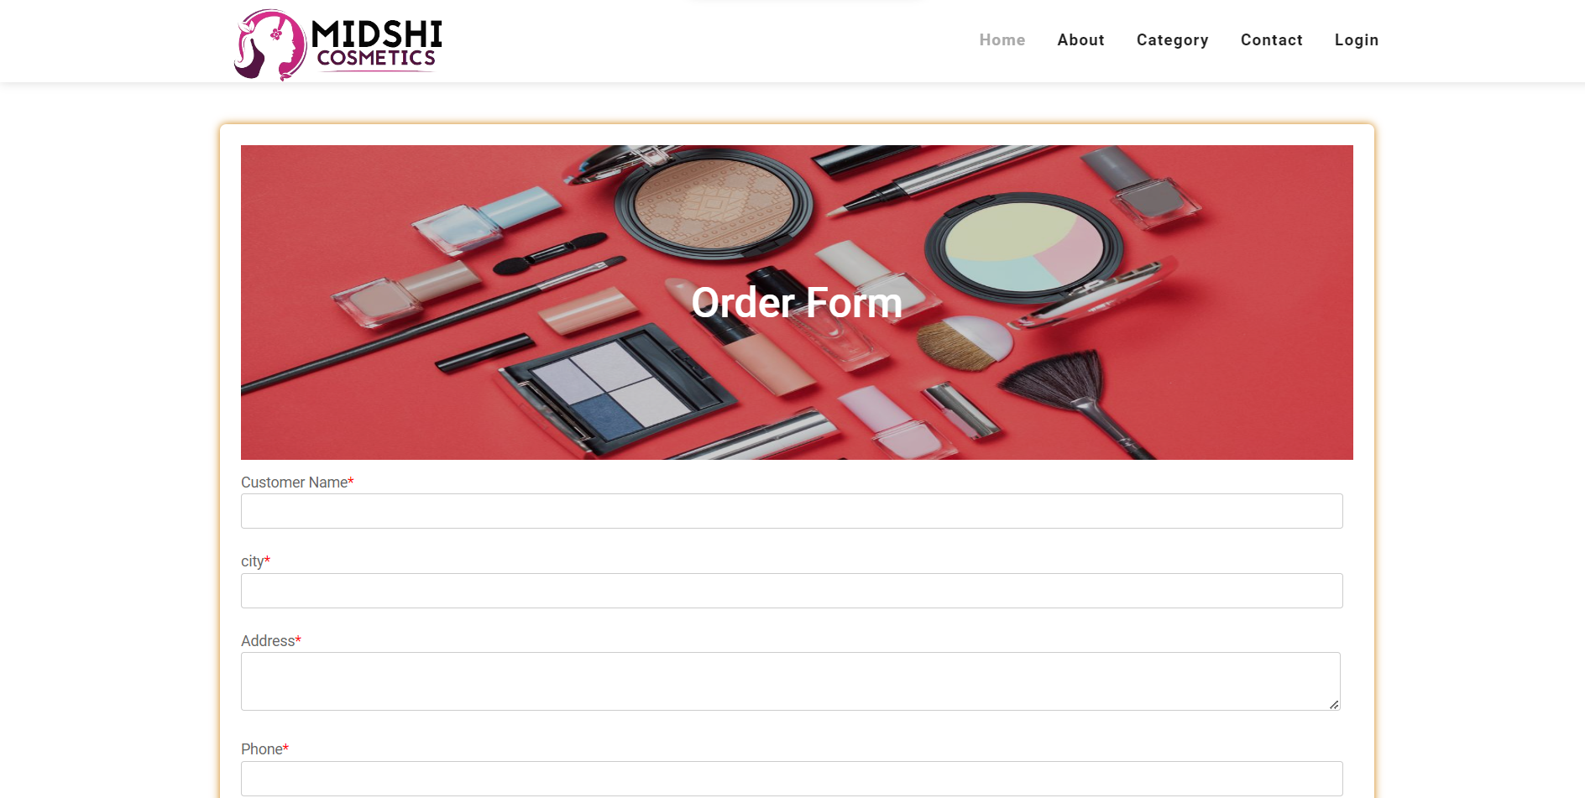
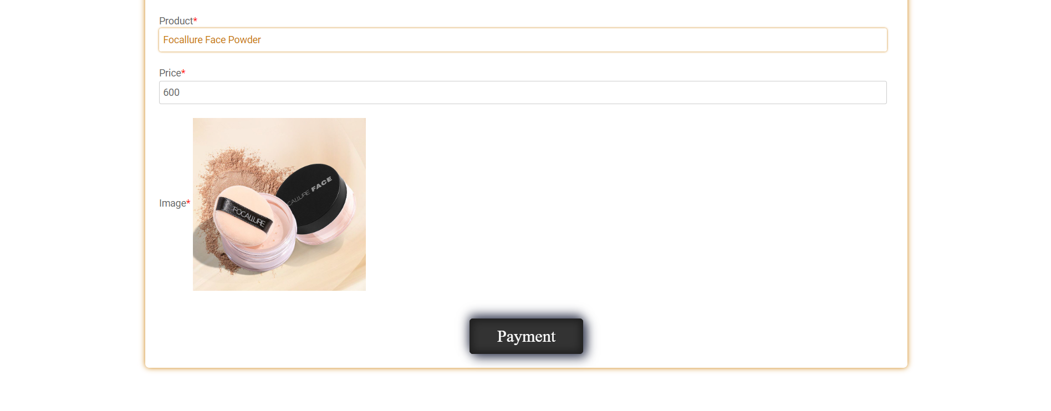
Order

Slide 27
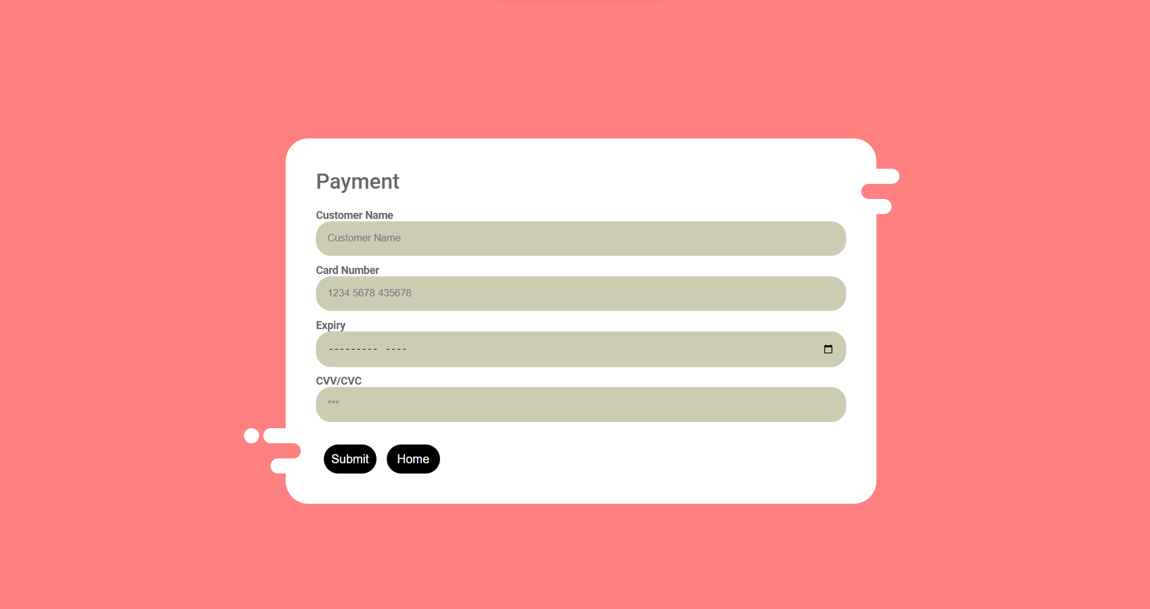
Payment

Slide 28
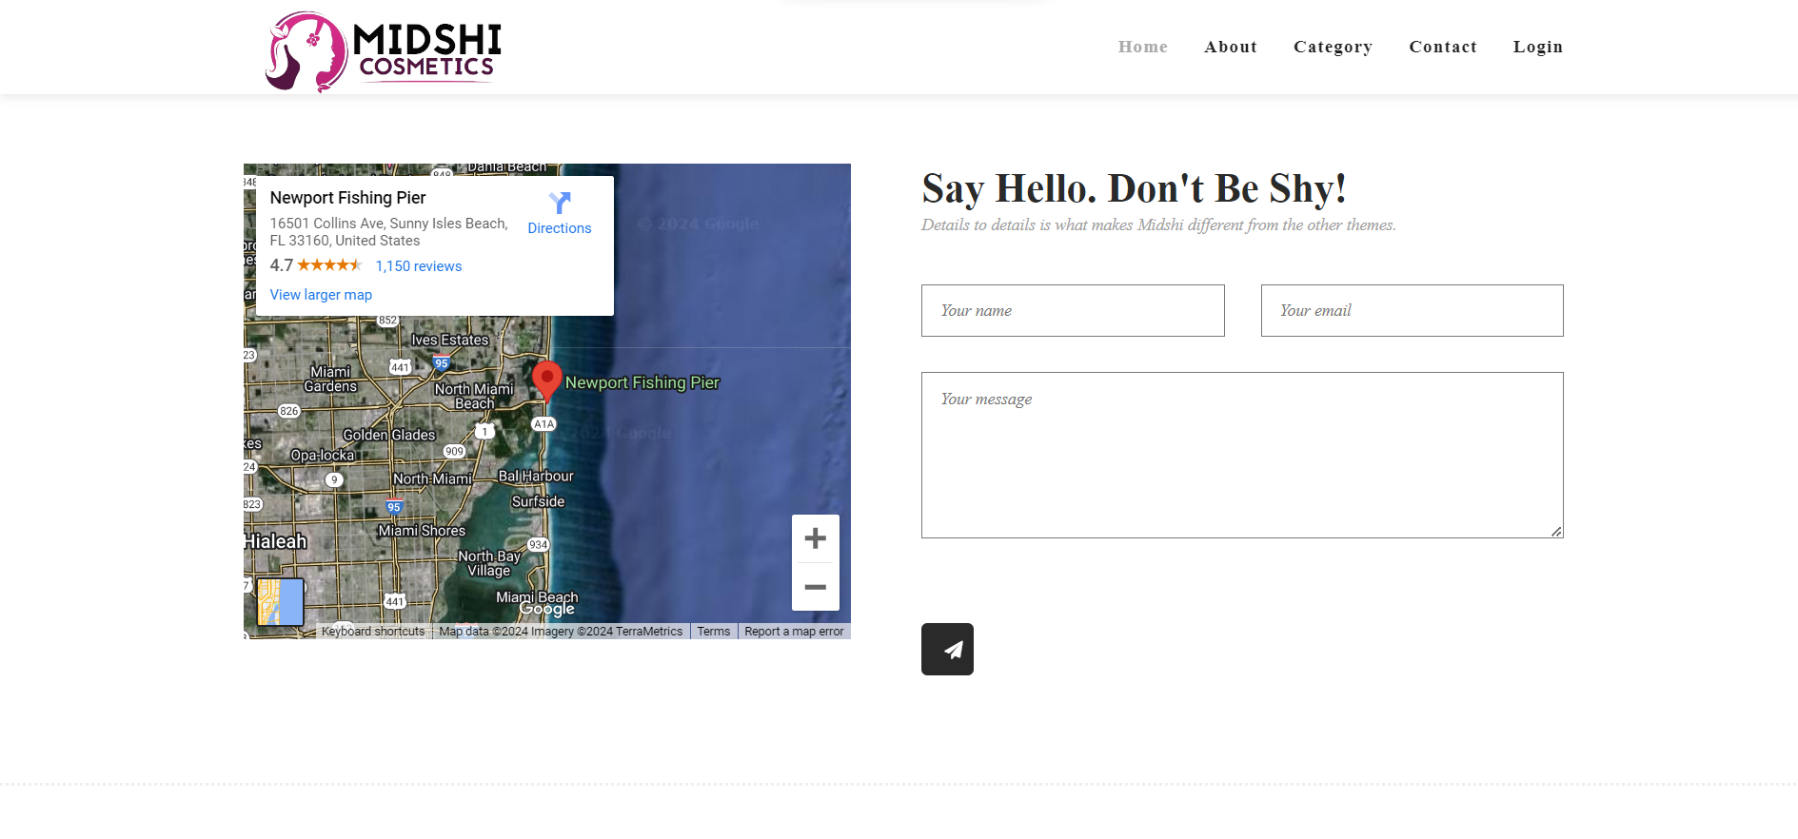
Contact

Slide 29
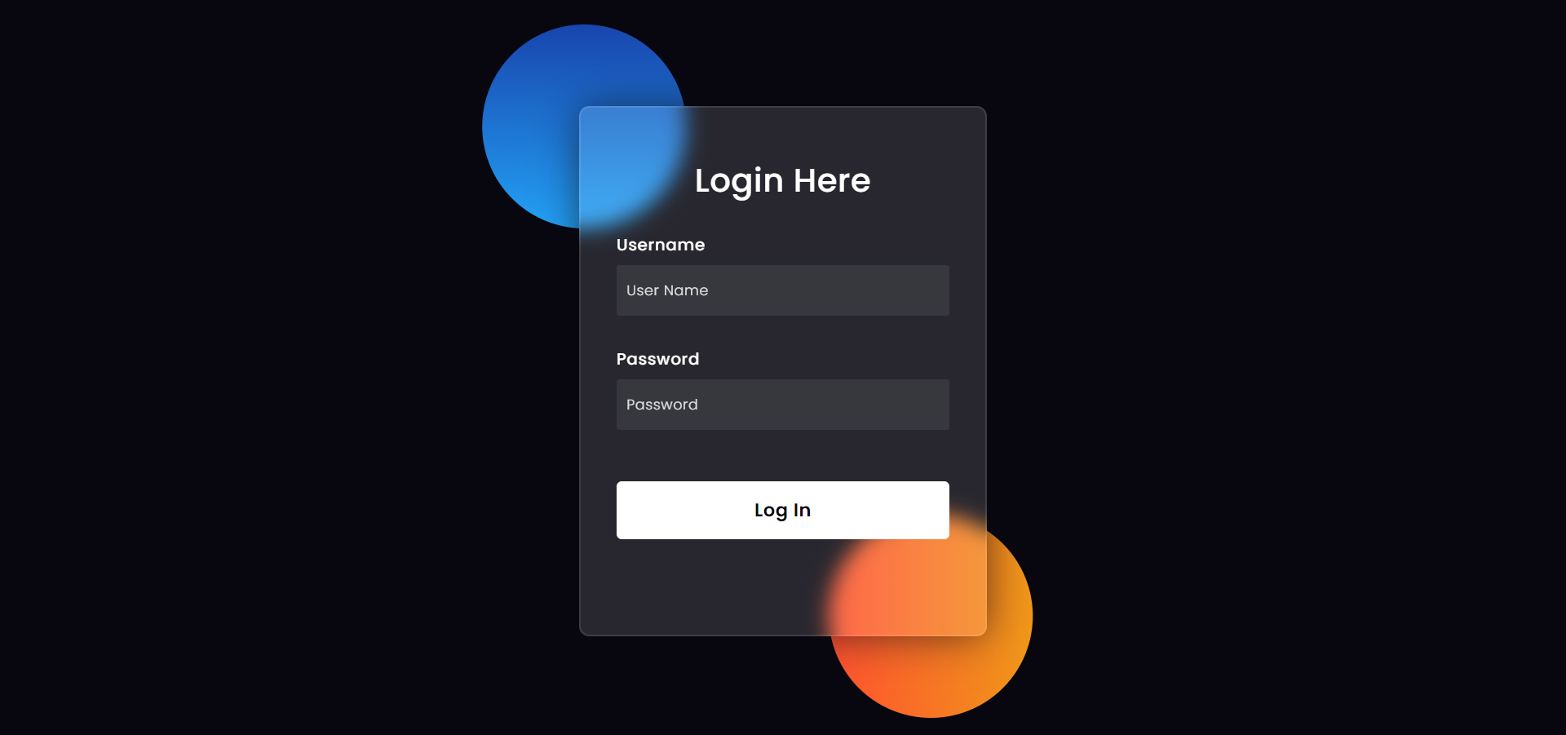
Login Form

Slide 30
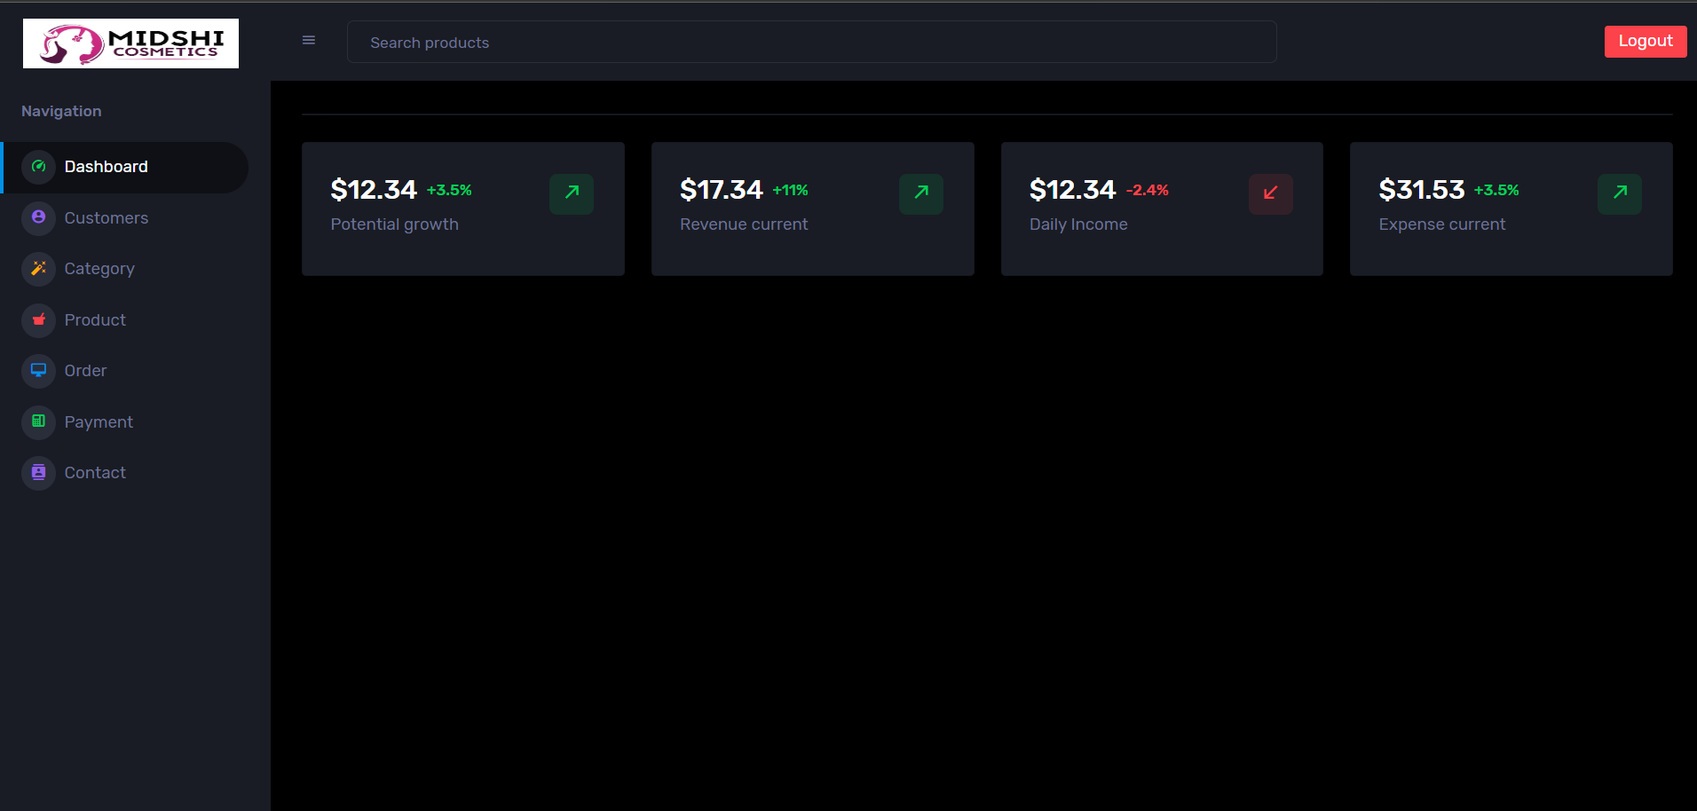
Dashboard

Slide 31
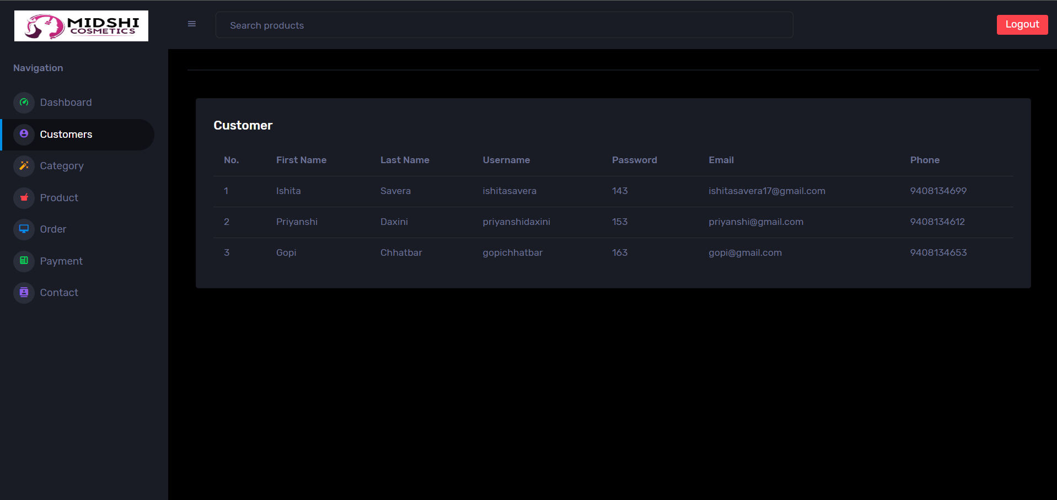
Customer

Slide 32
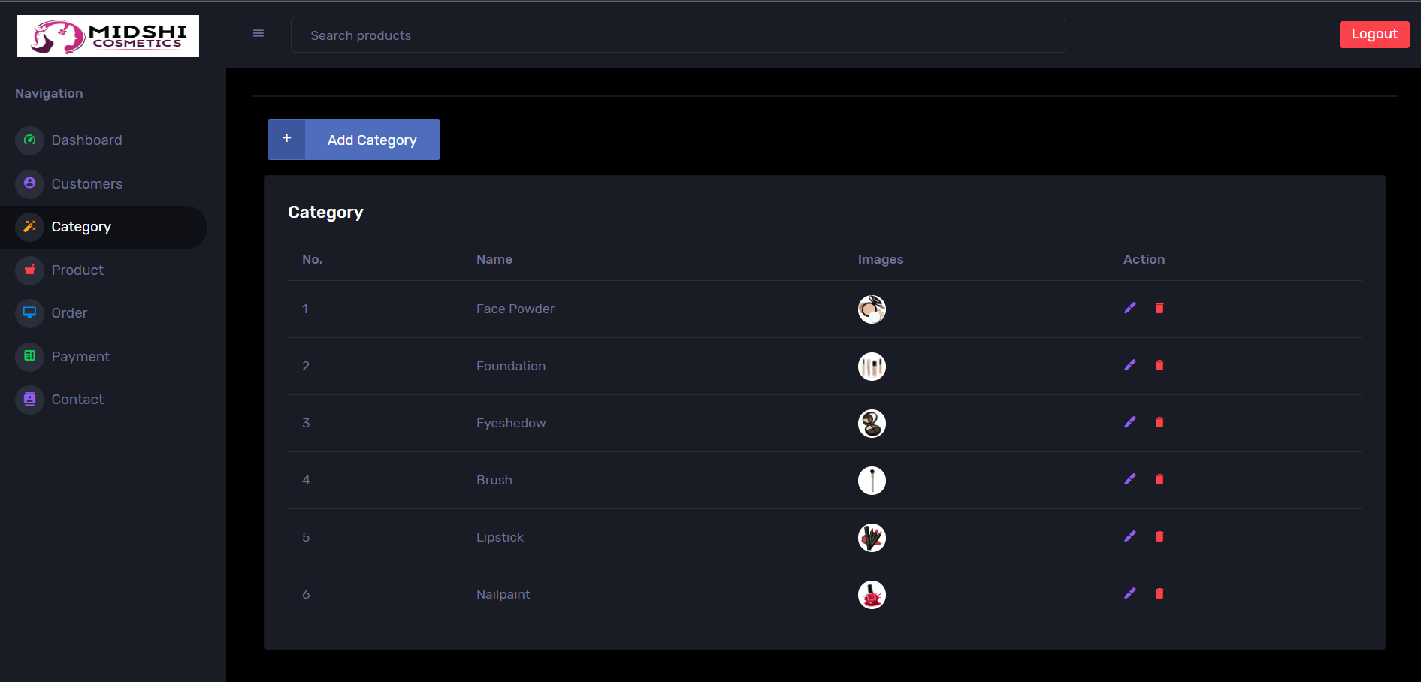
Category

Slide 33
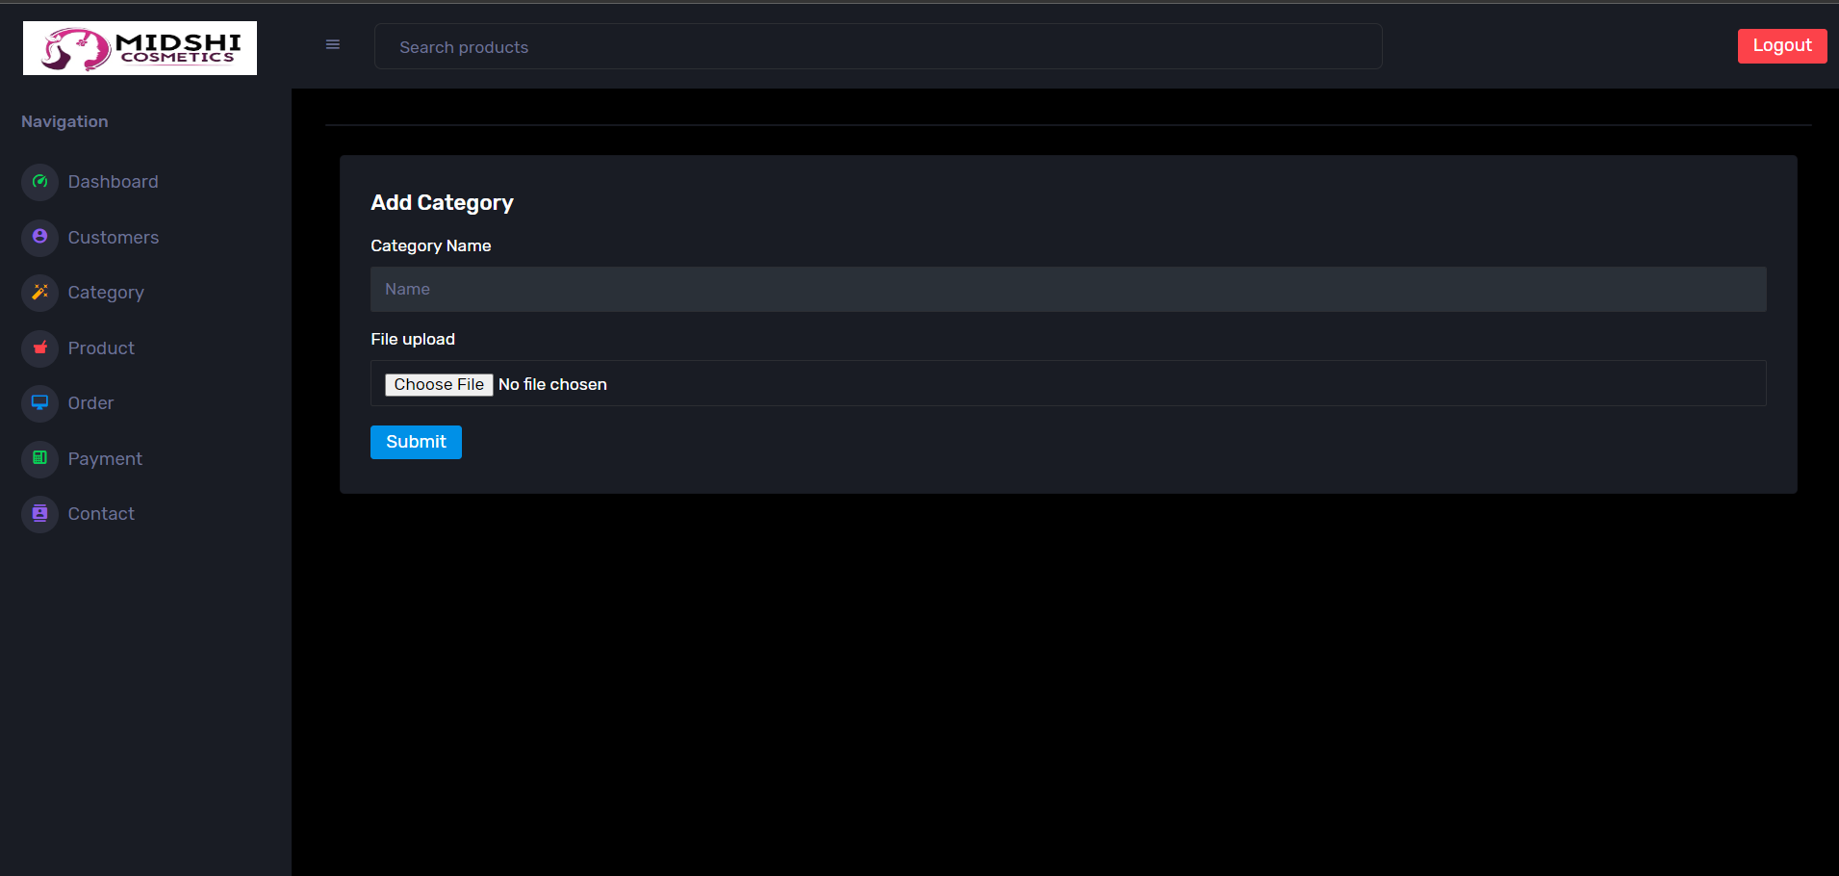
Add Category

Slide 34
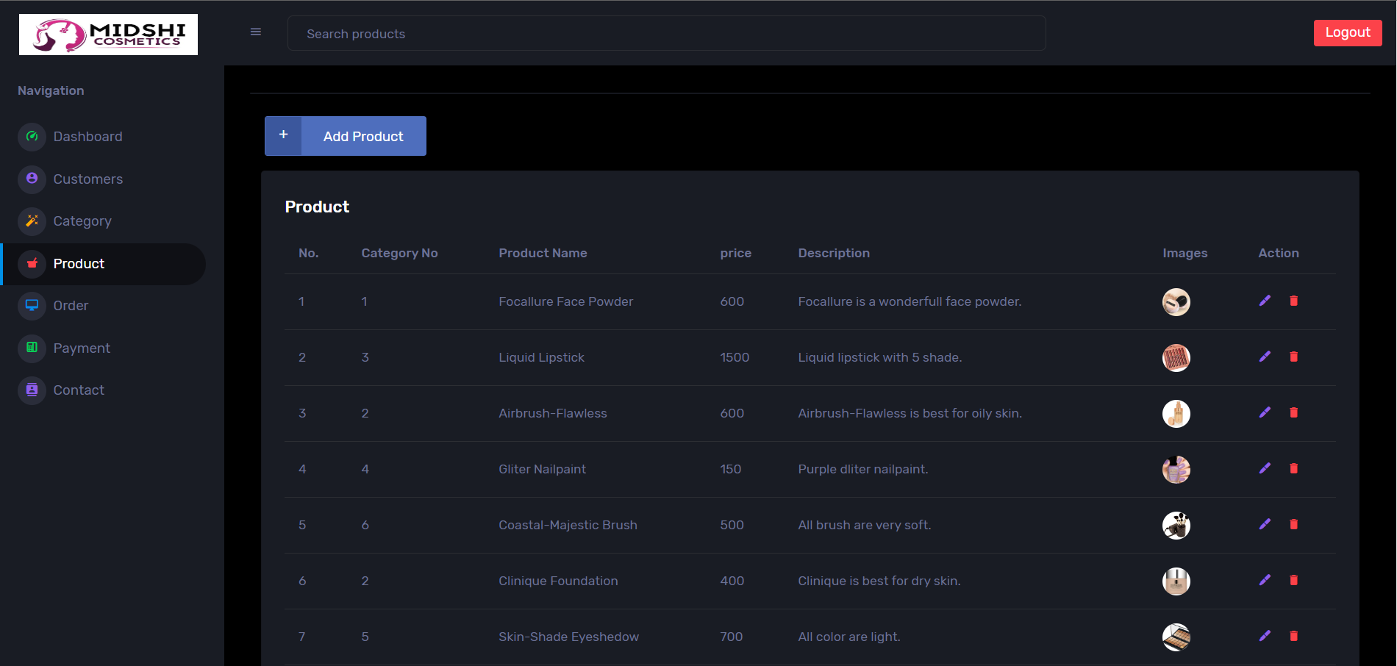
Product

Slide 35
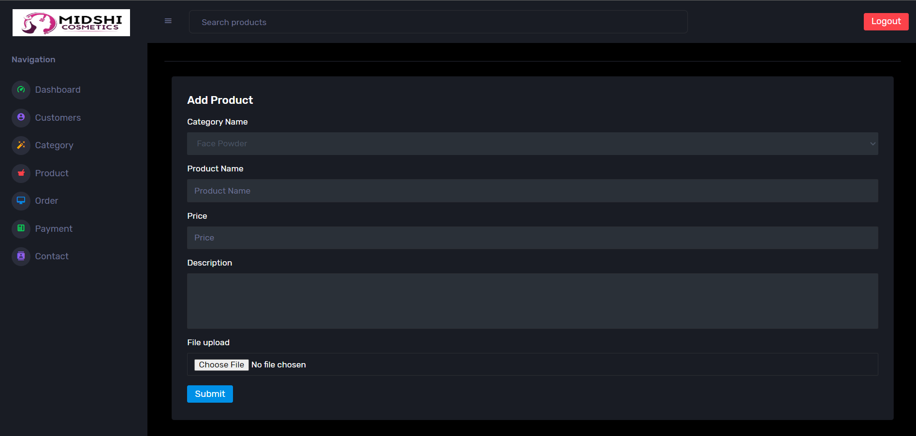
Add Product

Slide 36
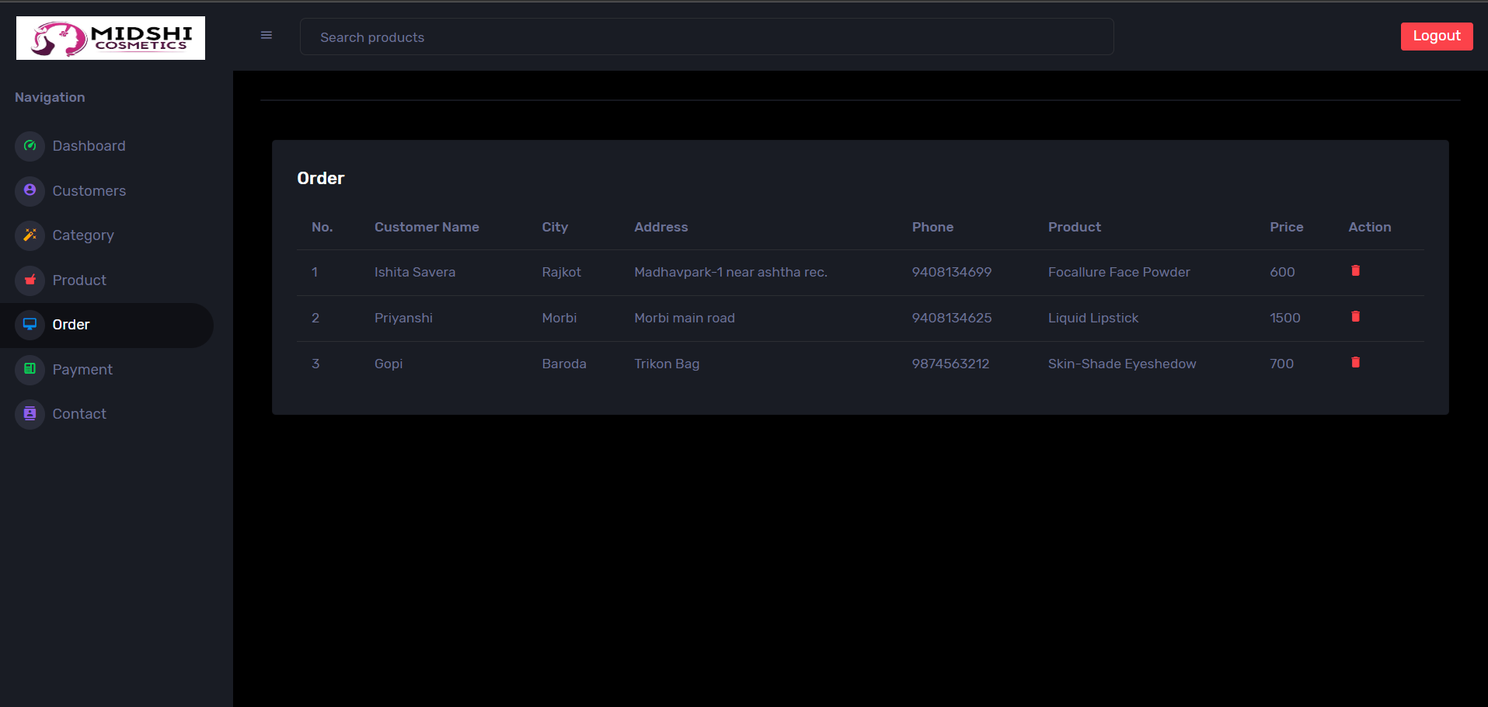
Order

Slide 37
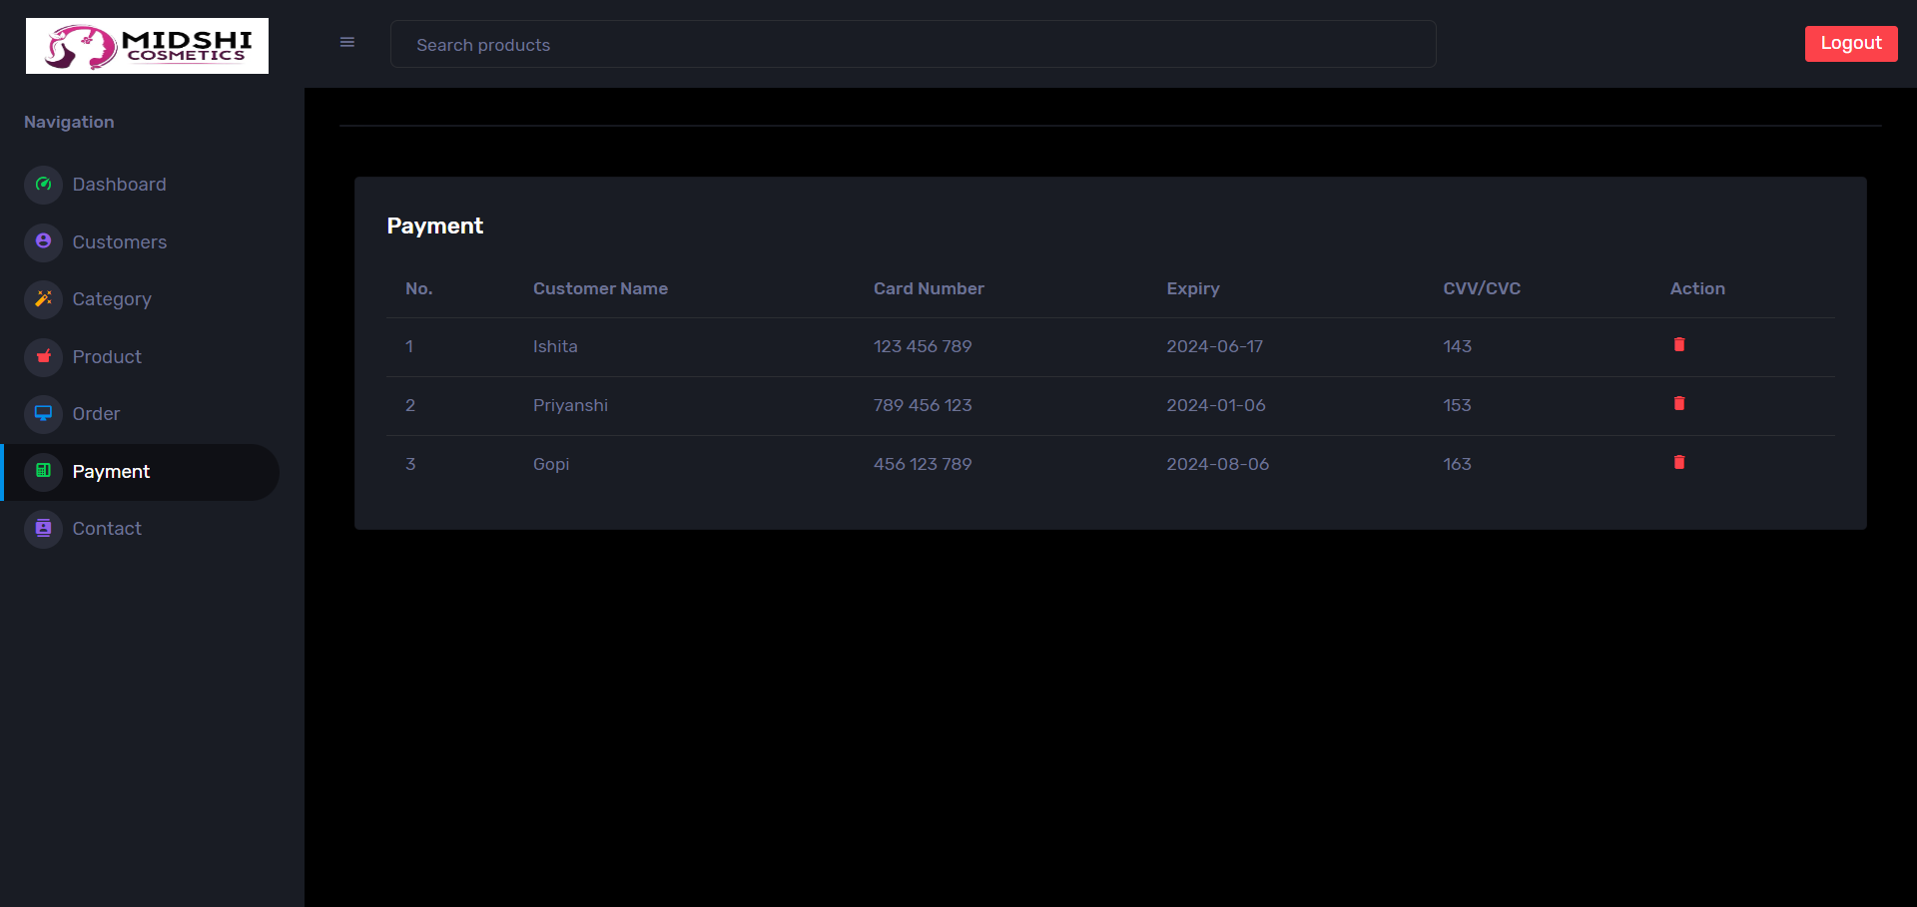
Payment

Slide 38
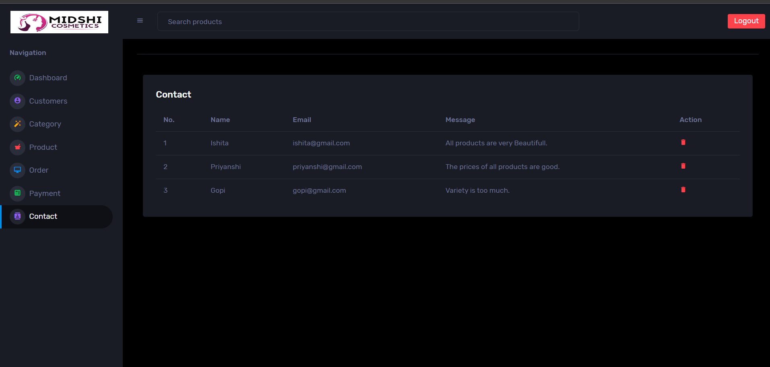
Contact

Slide 39

Websites
https://www.free-css.com
https://themewagon.com/themes/corona-free-responsive-bootstrap-4-admin-dashboard-template
https://www.img2go.com/result#j=41e0242a-2b33-4f73-a4b0-48543c34ec05

Slide 40
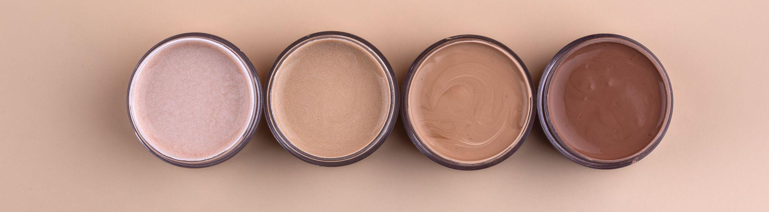
Thank You !

